Slide 1
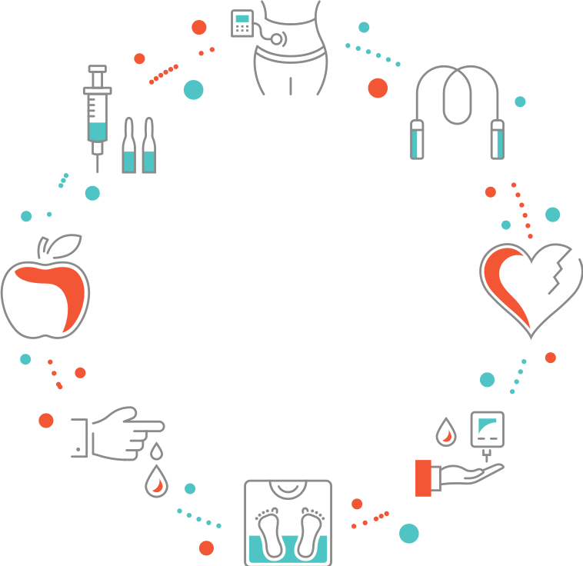

Working with Notoriously BIG Data
The guide to understanding the social factors that may contribute to obesity
Presenters: Alexei Flores, Leonard Zhao, Katrina Nguyen

Slide 2
Objective
The objective is to find if there is correlation between obesity rate and the following social factors:
Median household income
% Exercise opportunities
% Physically inactive
% Access to primary care physicians
High school graduation
% Unemployed
Notes:
For the purpose of this dataset:
Median household income means....
Exercise opportunities means...
Physical inactivity means...
Access to primary care physicians means...
High school unemployment rate means...
Unemployed rate means ...

Slide 3
Definitions
% Obesity rate – Percentage of adults that report BMI >=30
Median household income – The income of the householder and all other individuals 15 years old and over in the household
% Exercise opportunities – Percentage of the population with access to places for physical activity
% Physically inactive – Percentage of adults that report no leisure-time physical activity
Primary care physicians rate – Primary care physicians per 100,000 population
High school graduation – graduation rate
% Unemployed – Percentage of population ages 16+ unemployed and looking for work
Notes:
For the purpose of this dataset:
Median household income means....
Exercise opportunities means...
Physical inactivity means...
Access to primary care physicians means...
High school unemployment rate means...
Unemployed rate means ...

Slide 4
Data Collection and Sanitation Process
US Census for median household income
County Health Rankings for obesity rate and other social factors
Socrata open data source for latitude and longitudes per county
Google maps API to produce heatmap
Notes:
For the purpose of this dataset:
Median household income means....
Exercise opportunities means...
Physical inactivity means...
Access to primary care physicians means...
High school unemployment rate means...
Unemployed rate means ...

Slide 5
Obesity Rate vs. % Unemployed
40
40
40
30
30
30
20
20
20
10
10
10
0
0
0
Item 1
Item 2
Item 3
Item 4
Item 1
Item 2
Item 3
Item 4
Item 1
Item 2
Item 3
Item 4

Slide 6
Obesity Rate vs. % High School Graduation
40
40
40
30
30
30
20
20
20
10
10
10
0
0
0
Item 1
Item 2
Item 3
Item 4
Item 1
Item 2
Item 3
Item 4
Item 1
Item 2
Item 3
Item 4

Slide 7
Obesity Rate vs. % Access to Primary Care Physicians
40
40
40
30
30
30
20
20
20
10
10
10
0
0
0
Item 1
Item 2
Item 3
Item 4
Item 1
Item 2
Item 3
Item 4
Item 1
Item 2
Item 3
Item 4

Slide 8
Obesity Rate vs. Median Income
40
40
40
30
30
30
20
20
20
10
10
10
0
0
0
Item 1
Item 2
Item 3
Item 4
Item 1
Item 2
Item 3
Item 4
Item 1
Item 2
Item 3
Item 4

Slide 9
Obesity Rate vs. % Exercise Opportunities
40
40
40
30
30
30
20
20
20
10
10
10
0
0
0
Item 1
Item 2
Item 3
Item 4
Item 1
Item 2
Item 3
Item 4
Item 1
Item 2
Item 3
Item 4

Slide 10
Obesity Rate vs. % Of Physically Inactive
40
40
40
30
30
30
20
20
20
10
10
10
0
0
0
Item 1
Item 2
Item 3
Item 4
Item 1
Item 2
Item 3
Item 4
Item 1
Item 2
Item 3
Item 4

Slide 11
Obesity Rate Heatmap

Slide 12
Findings

Slide 13
Limitations

Slide 14
Eat well-balanced, healthy meals
Take care
of your body.
Exercise regularly
Stress less, meditate, and take deep breaths

